Slide 1
ENG 346
Data Structures and Algorithms for Artificial Intelligence
Statistical Operations and Numpy
Dr. Mehmet PEKMEZCİ
mpekmezci@gtu.edu.tr
https://github.com/mehmetpekmezci/GTU-ENG-346
ENG-346 Teams code is 0uv7jlm

Slide 2
Statistics
Statistics is the discipline that concerns the collection, organization, analysis, interpretation, and presentation of data.
Population: The entire group one desires information about. Universal Set.
Sample: A subset of population taken because the entire population is usually too large to analyze. Try to represent all the characteristics of the population (As much as you can).
Mean: The average
Median: The mid point.
Mode: The most common.

Slide 3
Statistics
Variance: Variance is a measure of how far the observed values in a dataset fall from the arithmetic mean, and is therefore a measure of spread - more specifically, it is a measure of variability.
Standard Deviation: (Square Root od Variance) .Standard deviation is a measure of spread - more specifically, it is a measure of dispersion (or, the measure of variability!).
Standard Error : (you can see how well your sample data represents your population.) Standard error is another measure of spread. The most common standard error is the standard error of the mean, and used to measure sampling error as it measures how accurately the mean of a sample distribution represents the mean of the population.

Slide 4

Mean-Median-Mode
Mean: The average
Median: The mid point.
Mode: The most common.
Example :
Speed = [99,86,87,88,111,86,103,87,94,78,77,85,86]
Mean = (99+...+86)/13=89.77
Median = 87 ( When sorted , 87 is in the middle)
Mode = 86 ( There are three 86 in the list)
import numpy as np
from scipy import stats as st
speed= [99,86,87,88,111,86,103,87,94,78,77,85,86]
mean=np.mean(speed)
median=np.median(speed)
mode=st.mode(speed)
print(f"Mean={mean}")
print(f"Median={median}")
print(f"Mode={mode[0]}, appears {mode[1]} times in the list.")

Slide 5
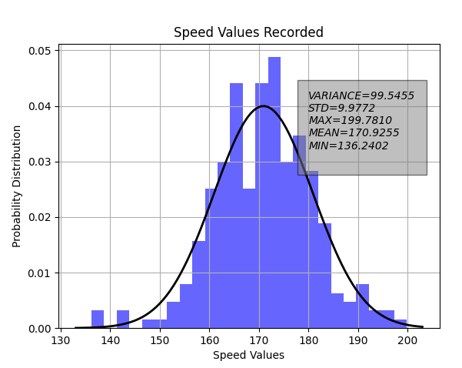

Variance / Standard Deviation
Variance: Variance is a measure of how far the observed values in a dataset fall from the arithmetic mean, and is therefore a measure of spread - more specifically, it is a measure of variability.
import numpy as np
from scipy.stats import norm
import matplotlib.pyplot as plt
data = np.random.normal(170, 10, 250) # 170 mean, 10 std, 250 number of samples
variance=np.var(data)
max_val=np.max(data)
min_val=np.min(data)
mu, std = norm.fit(data) # Fit a normal distribution to the data
plt.hist(data, bins=25, density=True, alpha=0.6, color='b')
# Plot the PDF.
xmin, xmax = plt.xlim()
x = np.linspace(xmin, xmax, 100)
p = norm.pdf(x, mu, std)
plt.plot(x, p, 'k', linewidth=2)
plt.title( "Speed Values Recorded")
plt.grid(True)
plt.text( 180,0.03, f"VARIANCE={float(variance):.4f}\n STD={float(std):.4f}\n"+
f"MAX={float(max_val):.4f}\n MEAN={float(mu):.4f}\n MIN={float(min_val):.4f}\n",
style='italic', bbox={ 'facecolor': 'gray','alpha': 0.5, 'pad': 10 })
plt.xlabel("Speed Values")
plt.ylabel("Probability Distribution")
plt.show()

